Slide 1
Determine the coupling strength in level attraction
Yutong Zhao
Jun 10th, 2019

Slide 2
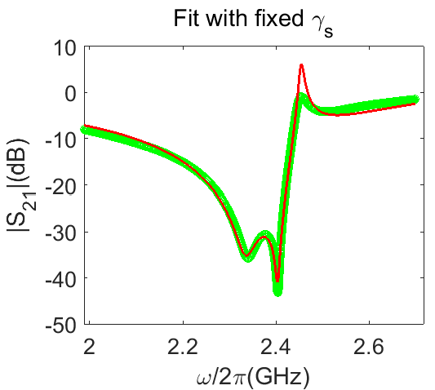
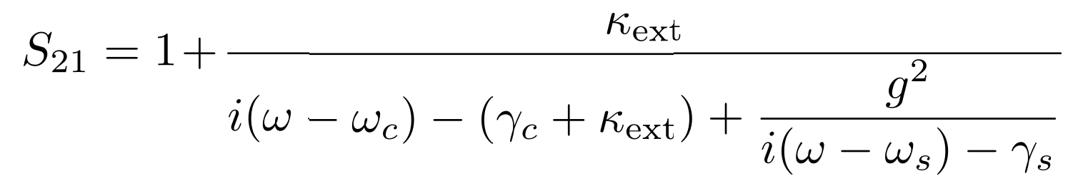
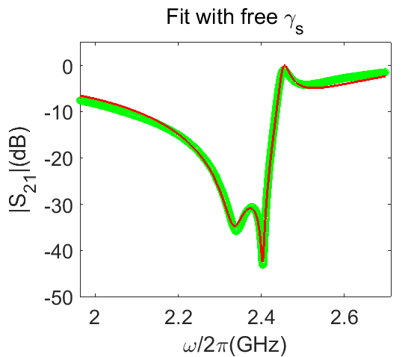

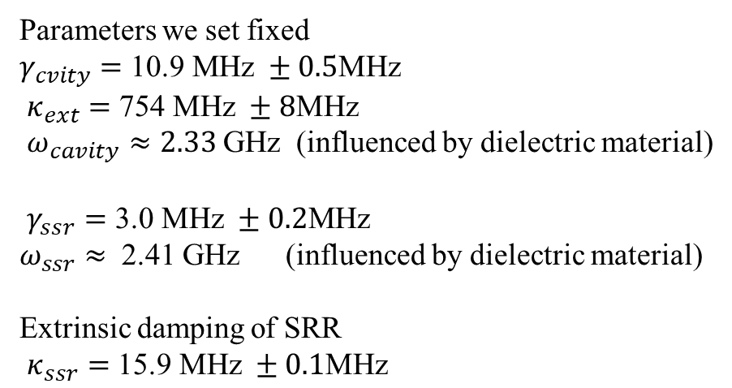
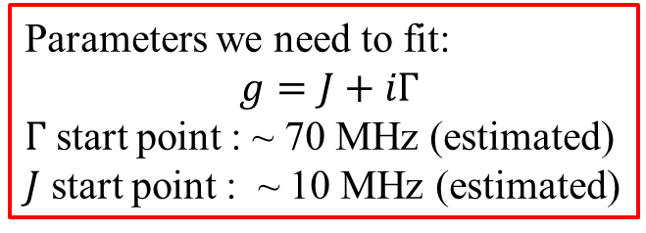

Determine the coupling strength without $ω_{s}$ mapping
Higher than zero!
Line shape of spectrum:
?
Parameters we set fixed
$γ_{cvity}=$ $\text{10.9} \text{MHz} ±0.5\text{MHz}$
$κ_{ext}=$ $\text{754} \text{MHz} ±8\text{MHz}$
$ω_{cavity}≈2.33$GHz (influenced by dielectric material)
$γ_{ssr}=\text{3.0 }\text{MHz} ±0.2\text{MHz}$
$ω_{ssr}≈$ 2.41 GHz (influenced by dielectric material)
Extrinsic damping of SRR
$κ_{ssr}=$ $\text{15.9} \text{MHz} ±0.1\text{MHz}$
?
$γ_{ssr}=\text{19.0} \text{MHz} ±0.1$ $\text{MHz}$
Parameters we need to fit:
$g=J+iΓ$
$Γ$ start point : ~ 70 MHz (estimated)
$J$ start point : ~ 10 MHz (estimated)
$J=17±1\text{MHz}$
$Γ=76.5±0.9\text{MHz}$

Slide 3
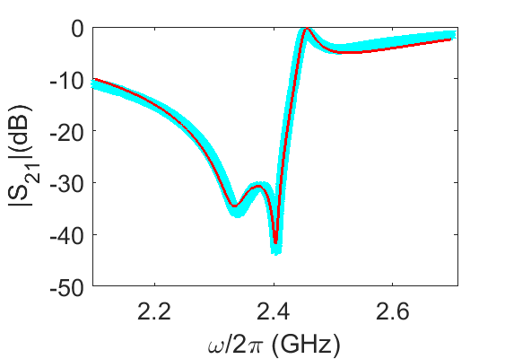
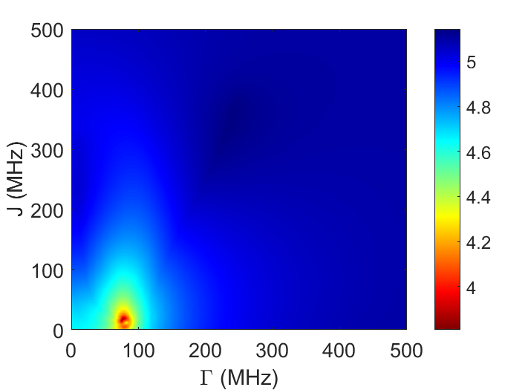
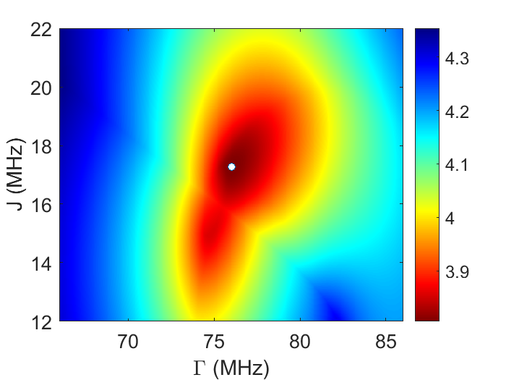

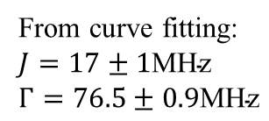
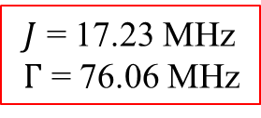
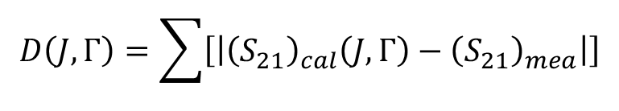

Fit with Robust parameter sweep
Solution space
$${\left(S_{21}\right)}_{cal}$$
Is this the only solution for $J$ and $Γ$ ?
$$D\left(J,Γ\right)=\sum{\left[\left|{\left(S_{21}\right)}_{cal}\left(J,Γ\right)−{\left(S_{21}\right)}_{mea}\right|\right]}$$
Large range view
Log (D)
Zoomed in View
Log (D)
$J$ = 17.23 MHz
$Γ$ = 76.06 MHz
From curve fitting:
$J=17±1\text{MHz}$
$Γ=76.5±0.9\text{MHz}$

Slide 4
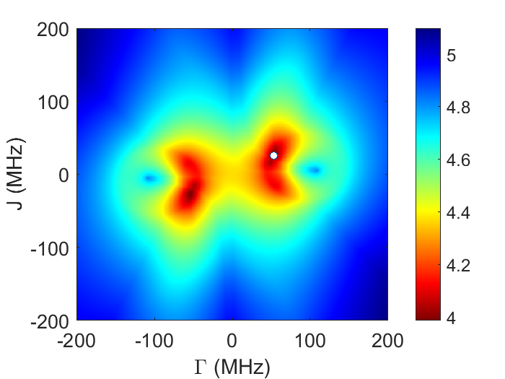
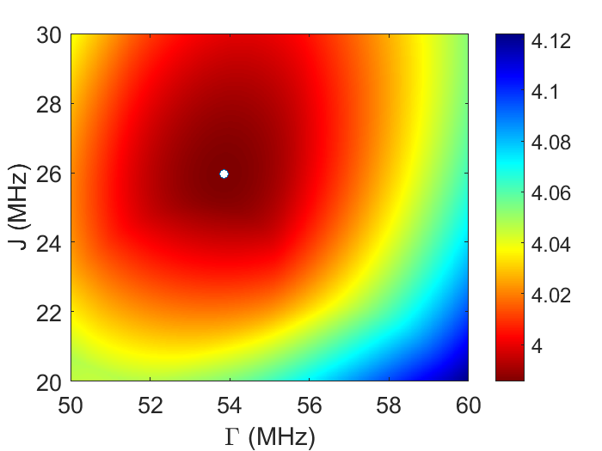
Further check: if $J$ and $Γ$ not always greater than zero
Large range view
Log (D)
Zoomed in View
Log (D)
→ There is only one set of the solution of $J$ and $Γ$ !

Slide 5
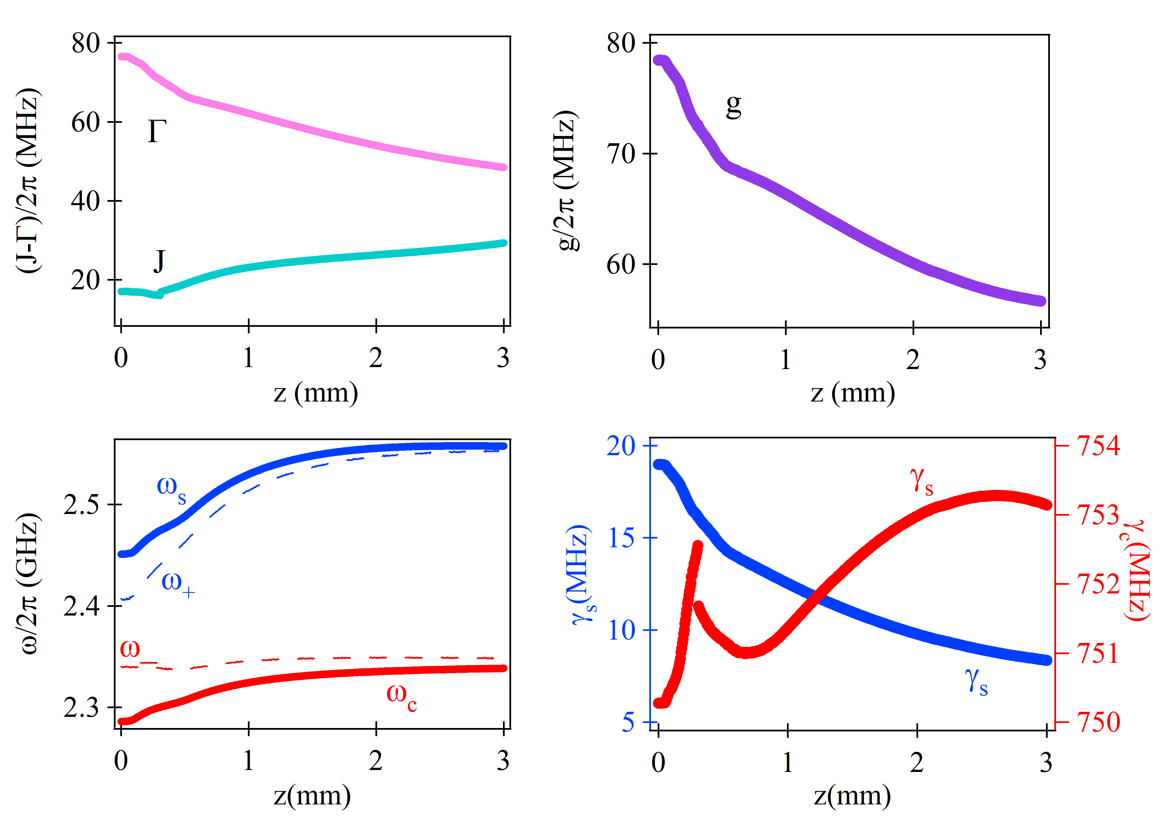
Fitting Results
Coupling strength
Total Coupling strength
Dispersion
Damping evolution

Slide 6
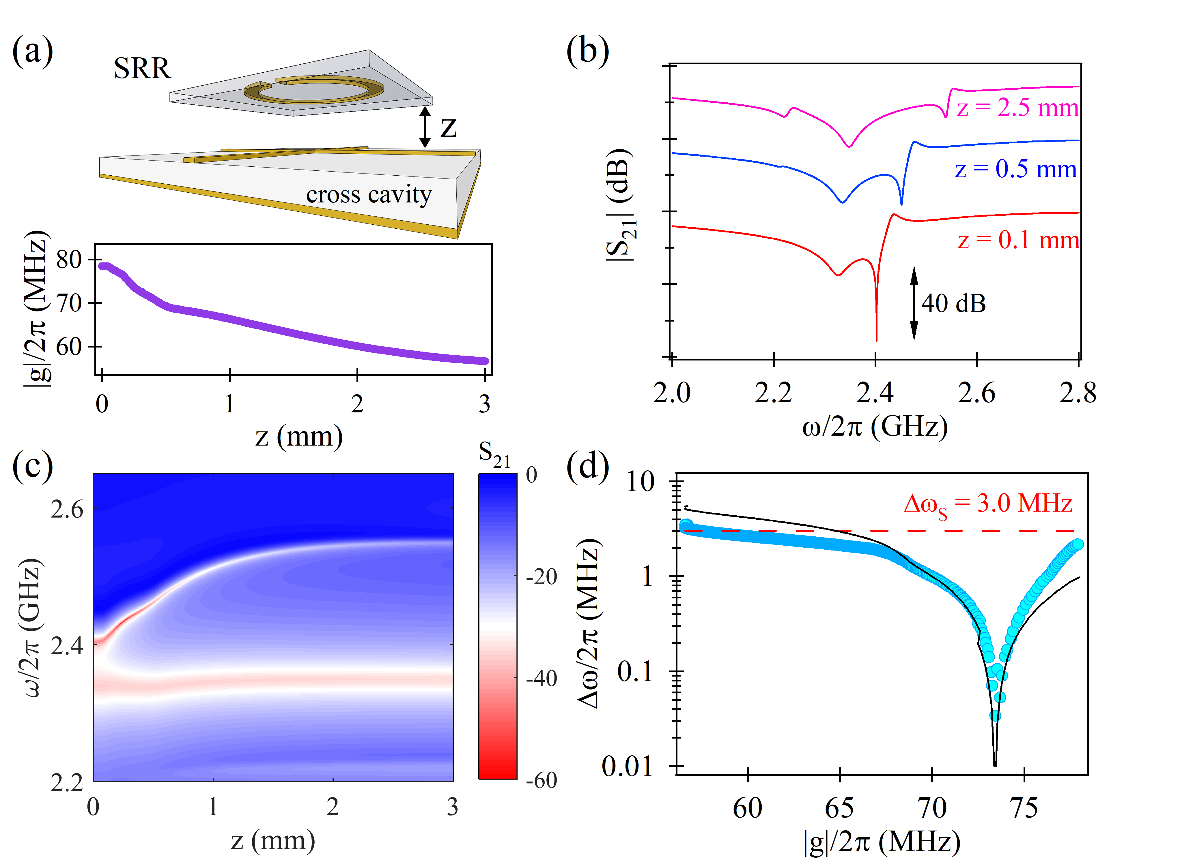
Modified Fig. 2
Calculation

Slide 7
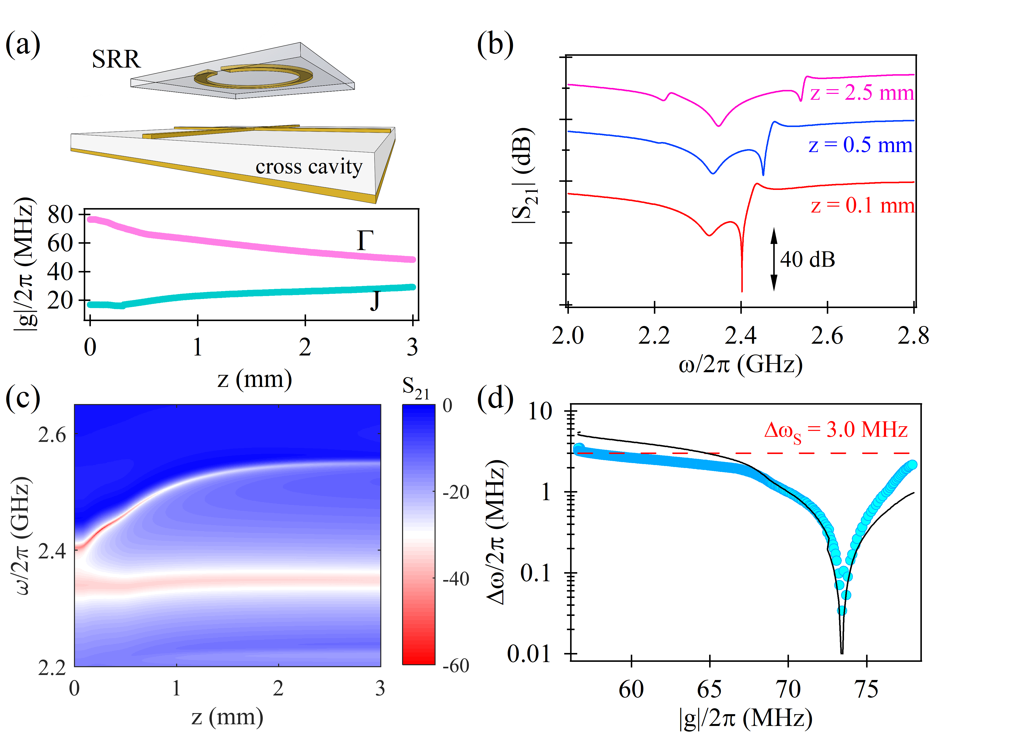
Alternatively
Calculation

